Slide 1
ECMO with Sepsis

Slide 2
Inclusion Criteria
ECMO insertion
From Jan 2014 to June 2020
(N=852)
Age >=18
(N=765)
Repeated ECMO insertion
(N=56)
First ECMO insertion
(N=709)

Slide 3
기존 디자인은 PreECMO Sepsis, Sepsis during ECMO, ECMO w/o sepsis 군간의 비교연구였으나
세군간 비교에서 유의한 결과가 확인되지 않았으며
Sepsis (culture positive) 진단이 ECMO 삽입 이후에 이루어지기에 ECMO 삽입 이후부터의 생존분석이 적절하지 않음
Sepsis during ECMO vs. ECMO w/o sepsis간의 비교연구로 전환하였습니다.
그 중에서도 BSI – blood culture (+) and/or catheter culture (+)의 임상적 의의에 중점을 두고자 하였습니다.

Slide 4
Survivors vs. Non-survivors
 | Survivors | Nonsurvivors | Total | p
 | (N=403) | (N=306) | (N=709)
Male | 269 (66.7%) | 204 (66.7%) | 473 (66.7%) | 1
Age | 55.6 ± 15.8 | 59.9 ± 13.9 | 57.4 ± 15.1 | < 0.001
Height | 165.2 ± 12.2 | 164.2 ± 8.8 | 164.8 ± 10.9 | 0.188
Weight | 66.5 ± 13.1 | 65.7 ± 13.0 | 66.1 ± 13.0 | 0.425
PMHx.
Malignancy | 40 ( 9.9%) | 68 (22.3%) | 108 (15.3%) | < 0.001
DM | 135 (33.5%) | 100 (32.7%) | 235 (33.1%) | 0.882
HTN | 143 (35.5%) | 135 (44.1%) | 278 (39.2%) | 0.024
Dyslipidemia | 46 (11.4%) | 40 (13.1%) | 86 (12.1%) | 0.569
Smoking | 165 (41.2%) | 127 (42.2%) | 292 (41.7%) | 0.862
Current smoker | 101 (25.2%) | 42 (14.0%) | 143 (20.4%) | < 0.001
CKD | 20 ( 5.0%) | 39 (12.8%) | 59 ( 8.3%) | < 0.001
PAOD | 5 ( 1.2%) | 15 ( 4.9%) | 20 ( 2.8%) | 0.007
Previous CVA | 25 ( 6.2%) | 21 ( 6.9%) | 46 ( 6.5%) | 0.833
Previous MI | 72 (17.9%) | 50 (16.4%) | 122 (17.3%) | 0.694
Prevous PCI | 89 (22.1%) | 57 (18.8%) | 146 (20.7%) | 0.322
Previous CABG | 26 ( 6.5%) | 20 ( 6.6%) | 46 ( 6.5%) | 1

Slide 5
Survivors vs. Non-survivors
 | Survivors | Nonsurvivors | Total | p
 | (N=403) | (N=306) | (N=709)
Lab
Hb | 12.0 ± 2.6 | 11.2 ± 2.5 | 11.7 ± 2.5 | < 0.001
Platelet | 202.1 ± 93.3 | 173.2 ± 108.8 | 188.9 ± 101.6 | 0.001
Sodium | 136.2 ± 10.1 | 136.6 ± 11.5 | 136.4 ± 10.8 | 0.709
Total bilirubin | 1.4 ± 1.6 | 1.6 ± 2.4 | 1.5 ± 2.0 | 0.26
AST | 294.5 ± 1135.8 | 209.0 ± 636.5 | 255.7 ± 942.6 | 0.291
ALT | 188.6 ± 570.5 | 132.0 ± 297.1 | 162.9 ± 467.2 | 0.156
LDH | 1137.1 ± 1615.8 | 1519.8 ± 2419.9 | 1315.5 ± 2036.4 | 0.093
BUN | 25.3 ± 17.2 | 32.0 ± 26.7 | 28.3 ± 22.2 | 0.001
Creatinine | 1.4 ± 1.2 | 2.0 ± 2.2 | 1.7 ± 1.8 | < 0.001
D-dimer | 11.1 ± 36.9 | 12.1 ± 15.7 | 11.6 ± 28.5 | 0.783
CRP | 4.7 ± 7.3 | 8.0 ± 10.8 | 6.2 ± 9.2 | < 0.001
TnI | 15.7 ± 58.5 | 19.5 ± 79.8 | 17.5 ± 69.3 | 0.626
Lactate 0h | 5.0 ± 4.4 | 7.0 ± 5.5 | 5.9 ± 5.0 | < 0.001
Lactate 6h | 9.6 ± 73.5 | 7.9 ± 5.7 | 8.9 ± 55.6 | 0.721
Lactate 24h | 2.8 ± 2.5 | 5.0 ± 4.7 | 3.7 ± 3.7 | < 0.001
Lactate 48h | 1.9 ± 1.1 | 4.2 ± 4.6 | 2.8 ± 3.3 | < 0.001

Slide 6
Survivors vs. Non-survivors
 | Survivors | Nonsurvivors | Total | p
 | (N=403) | (N=306) | (N=709)
ECPR | 128 (31.8%) | 137 (44.8%) | 265 (37.4%) | 0.001
ECMO Indication |  |  |  | < 0.001
Cardiopulmonary arrest | 160 (39.7%) | 151 (49.3%) | 311 (43.9%)
Cardiogenic shock | 134 (33.3%) | 50 (16.3%) | 184 (26.0%)
Respiratoy failure | 67 (16.6%) | 76 (24.8%) | 143 (20.2%)
Weaning faiure of CPB | 17 ( 4.2%) | 14 ( 4.6%) | 31 ( 4.4%)
Septic shock | 9 ( 2.2%) | 10 ( 3.3%) | 19 ( 2.7%)
Others | 16 ( 4.0%) | 5 ( 1.6%) | 21 ( 3.0%)
ECMO Type |  |  |  | 0.003
VA-ECMO | 327 (81.1%) | 222 (72.5%) | 549 (77.4%)
VV-ECMO | 71 (17.6%) | 81 (26.5%) | 152 (21.4%)
E-LVAD | 5 ( 1.2%) | 0 ( 0.0%) | 5 ( 0.7%)
E-RVAD | 0 ( 0.0%) | 2 ( 0.7%) | 2 ( 0.3%)
Others | 0 ( 0.0%) | 1 ( 0.3%) | 1 ( 0.1%)
MV at Insertion | 317 (79.1%) | 257 (84.3%) | 574 (81.3%) | 0.097
Weaning success |  |  |  | < 0.001
No | 0 ( 0.0%) | 183 (59.8%) | 183 (25.8%)
Yes | 399 (99.0%) | 123 (40.2%) | 522 (73.6%)
Transfer | 4 ( 1.0%) | 0 ( 0.0%) | 4 ( 0.6%)
ECMO duration | 10.8 ± 19.3 | 13.3 ± 21.5 | 11.9 ± 20.3 | 0.097
Survival discharge |  |  |  | < 0.001
No | 0 ( 0.0%) | 269 (87.9%) | 269 (38.2%)
Yes | 390 (97.7%) | 35 (11.4%) | 425 (60.3%)
Hopeless discharge | 9 ( 2.3%) | 2 ( 0.7%) | 11 ( 1.6%)
CRRT | 113 (28.0%) | 175 (57.2%) | 288 (40.6%) | < 0.001
Vasopressor | 364 (90.5%) | 292 (95.4%) | 656 (92.7%) | 0.02
IABP | 9 ( 2.2%) | 11 ( 3.6%) | 20 ( 2.8%) | 0.392

Slide 7
Survivors vs. Non-survivors
 | Survivors | Nonsurvivors | Total | p
 | (N=403) | (N=306) | (N=709)
Complication
Limb ischemia | 22 ( 5.5%) | 20 ( 6.5%) | 42 ( 5.9%) | 0.659
ECMO site bleeding | 46 (11.4%) | 27 ( 8.8%) | 73 (10.3%) | 0.318
Stroke | 17 ( 4.2%) | 18 ( 5.9%) | 35 ( 4.9%) | 0.402
GI bleeding | 20 ( 5.0%) | 20 ( 6.5%) | 40 ( 5.6%) | 0.462
Rhabdomyolysis | 6 ( 1.5%) | 5 ( 1.6%) | 11 ( 1.6%) | 1
Culture (+) | 224 (55.6%) | 189 (61.8%) | 413 (58.3%) | 0.115
Culture (+) w/i 1M before ECMO | 60 (14.9%) | 55 (18.0%) | 115 (16.2%) | 0.317
Culture(+) during ECMO | 196 (48.6%) | 168 (54.9%) | 364 (51.3%) | 0.115
BSI | 50 (12.4%) | 81 (26.5%) | 131 (18.5%) | < 0.001
RTI | 128 (31.8%) | 115 (37.6%) | 243 (34.3%) | 0.124
UTI | 63 (15.6%) | 70 (22.9%) | 133 (18.8%) | 0.019
SSI | 5 ( 1.2%) | 8 ( 2.6%) | 13 ( 1.8%) | 0.286
Early Culture (+) (w/i 7d after ECMO) | 150 (37.2%) | 125 (40.8%) | 275 (38.8%) | 0.366
Early BSI | 26 ( 6.5%) | 47 (15.4%) | 73 (10.3%) | < 0.001
Early RTI | 83 (20.6%) | 69 (22.5%) | 152 (21.4%) | 0.592
Early UTI | 44 (10.9%) | 34 (11.1%) | 78 (11.0%) | 1
Early SSI | 1 ( 0.2%) | 1 ( 0.3%) | 2 ( 0.3%) | 1

Slide 8
# of Cases & Top 10 organisms
Total (2414/12522) |  | BSI (628/6030) |  | RTI (870/2736) |  | UTI (307/1285) |  | SSI (30/70) |  | Others (579/2401)
Organism | Freqeuncy | Organism | Freqeuncy | Organism | Freqeuncy | Organism | Freqeuncy | Organism | Freqeuncy | Organism | Freqeuncy
Staphylococcus aureus | 361 | Staphylococcus aureus | 124 | Acinetobacter baumannii complex | 245 | Candida albicans | 101 | Acinetobacter baumannii | 8 | Staphylococcus aureus | 112
Acinetobacter baumannii complex | 344 | Enterococcus faecium | 114 | Stenotrophomonas maltophilia | 137 | Candida glabrata | 28 | Klebsiella pneumoniae | 7 | Candida albicans | 92
Candida albicans | 237 | Klebsiella pneumoniae | 49 | Pseudomonas aeruginosa | 130 | Candida tropicalis | 28 | Acinetobacter baumannii complex | 5 | Enterococcus faecium | 85
Enterococcus faecium | 230 | Enterococcus faecalis | 45 | Staphylococcus aureus | 120 | Enterococcus faecium | 28 | Candida albicans | 3 | Klebsiella pneumoniae | 66
Pseudomonas aeruginosa | 199 | Acinetobacter baumannii complex | 42 | Acinetobacter baumannii | 45 | Candida parapsilosis | 27 | Staphylococcus aureus | 3 | Acinetobacter baumannii complex | 50
Stenotrophomonas maltophilia | 199 | Candida albicans | 38 | Klebsiella pneumoniae | 40 | Enterococcus faecalis | 20 | Candida parapsilosis | 2 | Escherichia coli | 41
Klebsiella pneumoniae | 170 | Acinetobacter baumannii | 31 | Corynebacterium striatum | 34 | Candida species | 19 | Enterococcus faecium | 2 | Pseudomonas aeruginosa | 41
Acinetobacter baumannii | 114 | Pseudomonas aeruginosa | 25 | Burkholderia cenocepacia | 26 | Escherichia coli | 15 | Candida tropicalis | 1 | Stenotrophomonas maltophilia | 37
Escherichia coli | 90 | Stenotrophomonas maltophilia | 25 | Escherichia coli | 25 | Klebsiella pneumoniae | 8 | Enterobacter aerogenes | 1 | MRSA | 27
Enterococcus faecalis | 75 | Staphylococcus epidermidis | 15 | Enterobacter aerogenes | 18 | Coagulase negative Staphylococcus | 7 | Staphylococcus epidermidis | 1 | Acinetobacter baumannii | 26
Notes:
ECMO 유지기간 동안 총 12522회의 culture가 시행되었으며 2414회에서 양성 결과 확인되었습니다.
각 검체별로 가장 빈번한 top 10 병원균 나열하였습니다.

Slide 9
Total infection
Culture (+)인 환자들 중 생존자 vs 사망자
균주 구성의 차이 분석
 | Survivors | Nonsurvivors | Total | p
 | (N=196) | (N=168) | (N=364)
Staphylococcus_aureus | 48 (24.5%) | 41 (24.4%) | 89 (24.5%) | 1
Acinetobacter_baumannii_complex | 42 (21.4%) | 44 (26.2%) | 86 (23.6%) | 0.346
Candida_albicans | 32 (16.3%) | 31 (18.5%) | 63 (17.3%) | 0.692
Enterococcus_faecium | 13 ( 6.6%) | 33 (19.6%) | 46 (12.6%) | < 0.001
Pseudomonas_aeruginosa | 21 (10.7%) | 21 (12.5%) | 42 (11.5%) | 0.714
Stenotrophomonas_maltophilia | 20 (10.2%) | 16 ( 9.5%) | 36 ( 9.9%) | 0.968
Klebsiella_pneumoniae | 16 ( 8.2%) | 22 (13.1%) | 38 (10.4%) | 0.173
Acinetobacter_baumannii | 9 ( 4.6%) | 11 ( 6.5%) | 20 ( 5.5%) | 0.558
Escherichia_coli | 18 ( 9.2%) | 18 (10.7%) | 36 ( 9.9%) | 0.755
Enterococcus_faecalis | 15 ( 7.7%) | 11 ( 6.5%) | 26 ( 7.1%) | 0.838
Others | 111 (56.6%) | 93 (55.4%) | 204 (56.0%) | 0.89

Slide 10
BSI
BSI 환자들 중 생존자 vs 사망자
균주 구성의 차이 분석
 | Survivors | Nonsurvivors | Total | p
 | (N=50) | (N=81) | (N=131)
Staphylococcus_aureus | 10 (20.0%) | 14 (17.3%) | 24 (18.3%) | 0.875
Enterococcus_faecium | 7 (14.0%) | 19 (23.5%) | 26 (19.8%) | 0.274
Klebsiella_pneumoniae | 1 ( 2.0%) | 5 ( 6.2%) | 6 ( 4.6%) | 0.497
Enterococcus_faecalis | 5 (10.0%) | 2 ( 2.5%) | 7 ( 5.3%) | 0.144
Acinetobacter_baumannii_complex | 3 ( 6.0%) | 9 (11.1%) | 12 ( 9.2%) | 0.501
Candida_albicans | 1 ( 2.0%) | 6 ( 7.4%) | 7 ( 5.3%) | 0.349
Acinetobacter_baumannii | 1 ( 2.0%) | 3 ( 3.7%) | 4 ( 3.1%) | 0.978
Pseudomonas_aeruginosa | 4 ( 8.0%) | 4 ( 4.9%) | 8 ( 6.1%) | 0.737
Stenotrophomonas_maltophilia | 2 ( 4.0%) | 1 ( 1.2%) | 3 ( 2.3%) | 0.67
Staphylococcus_epidermidis | 6 (12.0%) | 7 ( 8.6%) | 13 ( 9.9%) | 0.746
Others | 24 (48.0%) | 33 (40.7%) | 57 (43.5%) | 0.527

Slide 11
BSI
BSI 환자들 중 ECMO weaning vs Death on ECMO 비교
균주 구성의 차이 분석
 | Weaned | Death | Total | p
 | (N=74) | (N=57) | (N=131)
Staphylococcus_aureus | 15 (20.3%) | 9 (15.8%) | 24 (18.3%) | 0.668
Enterococcus_faecium | 9 (12.2%) | 17 (29.8%) | 26 (19.8%) | 0.022
Klebsiella_pneumoniae | 1 ( 1.4%) | 5 ( 8.8%) | 6 ( 4.6%) | 0.111
Enterococcus_faecalis | 6 ( 8.1%) | 1 ( 1.8%) | 7 ( 5.3%) | 0.226
Acinetobacter_baumannii_complex | 3 ( 4.1%) | 9 (15.8%) | 12 ( 9.2%) | 0.045
Candida_albicans | 1 ( 1.4%) | 6 (10.5%) | 7 ( 5.3%) | 0.054
Acinetobacter_baumannii | 1 ( 1.4%) | 3 ( 5.3%) | 4 ( 3.1%) | 0.437
Pseudomonas_aeruginosa | 6 ( 8.1%) | 2 ( 3.5%) | 8 ( 6.1%) | 0.47
Stenotrophomonas_maltophilia | 2 ( 2.7%) | 1 ( 1.8%) | 3 ( 2.3%) | 1
Staphylococcus_epidermidis | 9 (12.2%) | 4 ( 7.0%) | 13 ( 9.9%) | 0.495
Others | 35 (47.3%) | 22 (38.6%) | 57 (43.5%) | 0.413

Slide 12
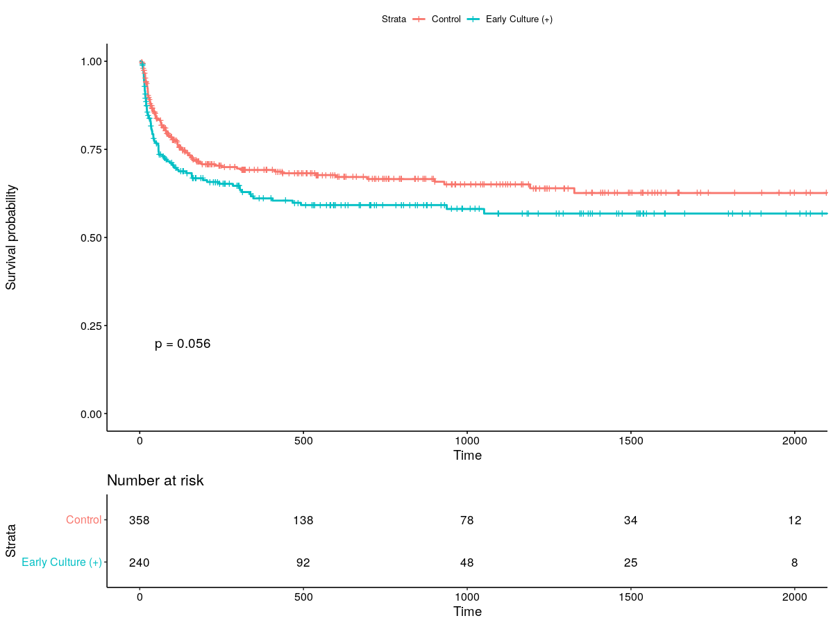
Cx (+) within 7d after ECMO
ECMO duration >7 인 환자들을 대상으로
ECMO 삽입 7일 이내 culture (+) vs. culture (-)

Slide 13
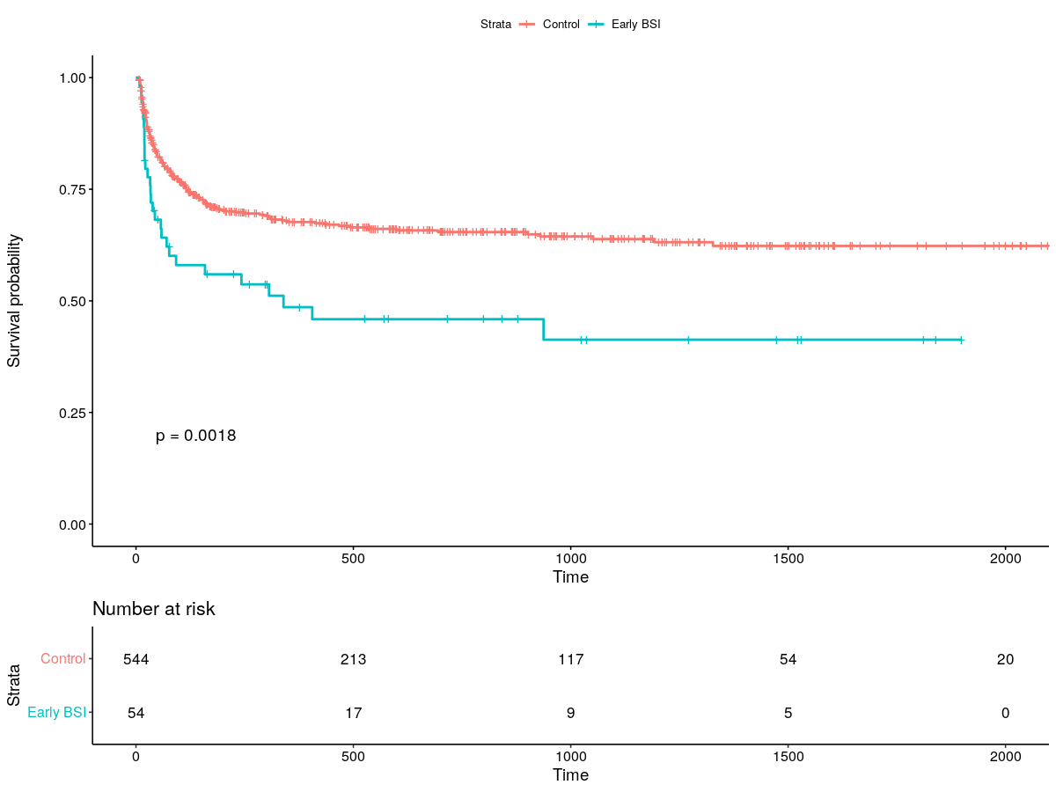
BSI within 7d after ECMO
마찬가지로
ECMO duration >7 인 환자들을 대상으로
ECMO 삽입 7일 이내 blood culture (+) vs. culture (-)

Slide 14
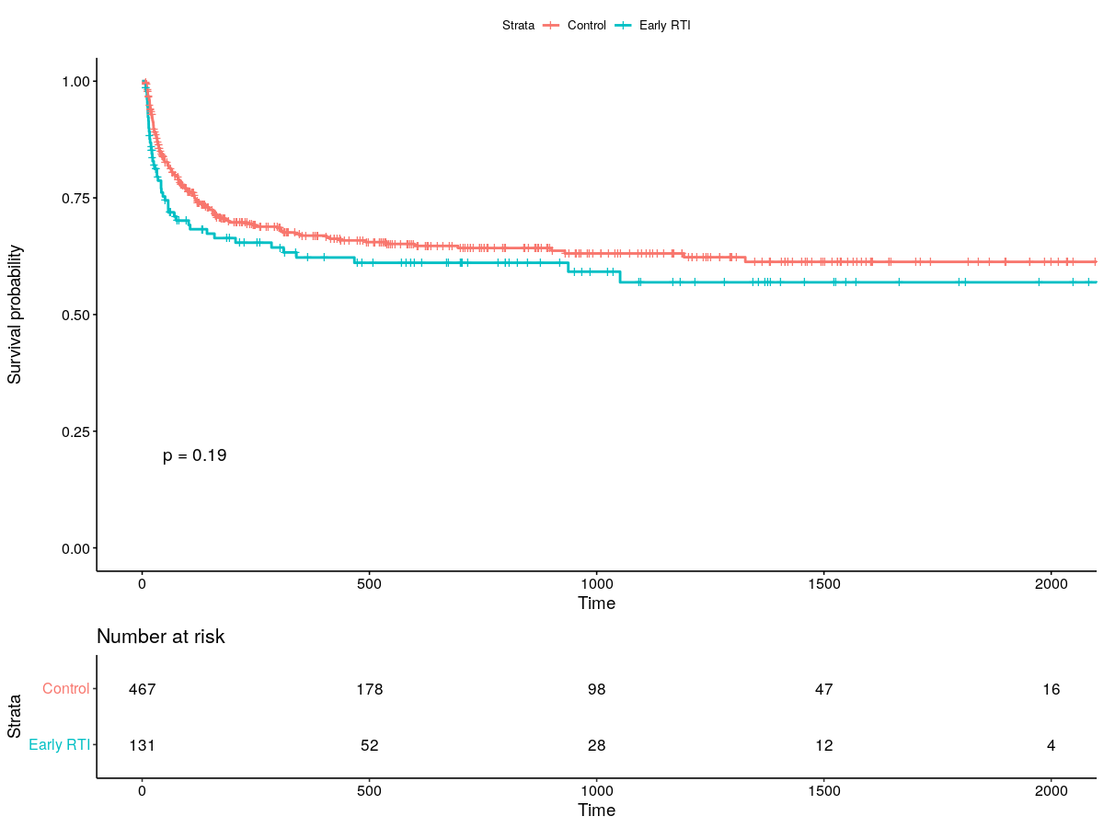
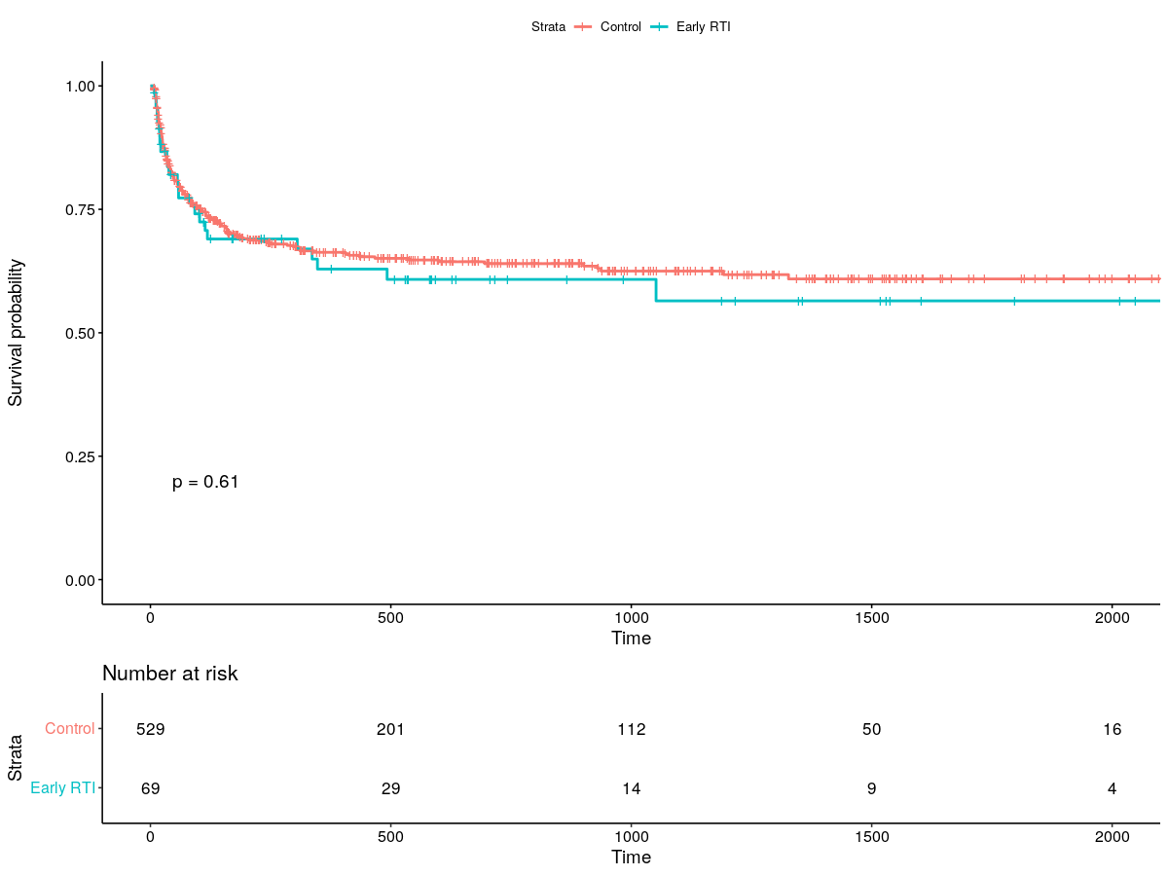
RTI/UTI within 7d after ECMO

Slide 15
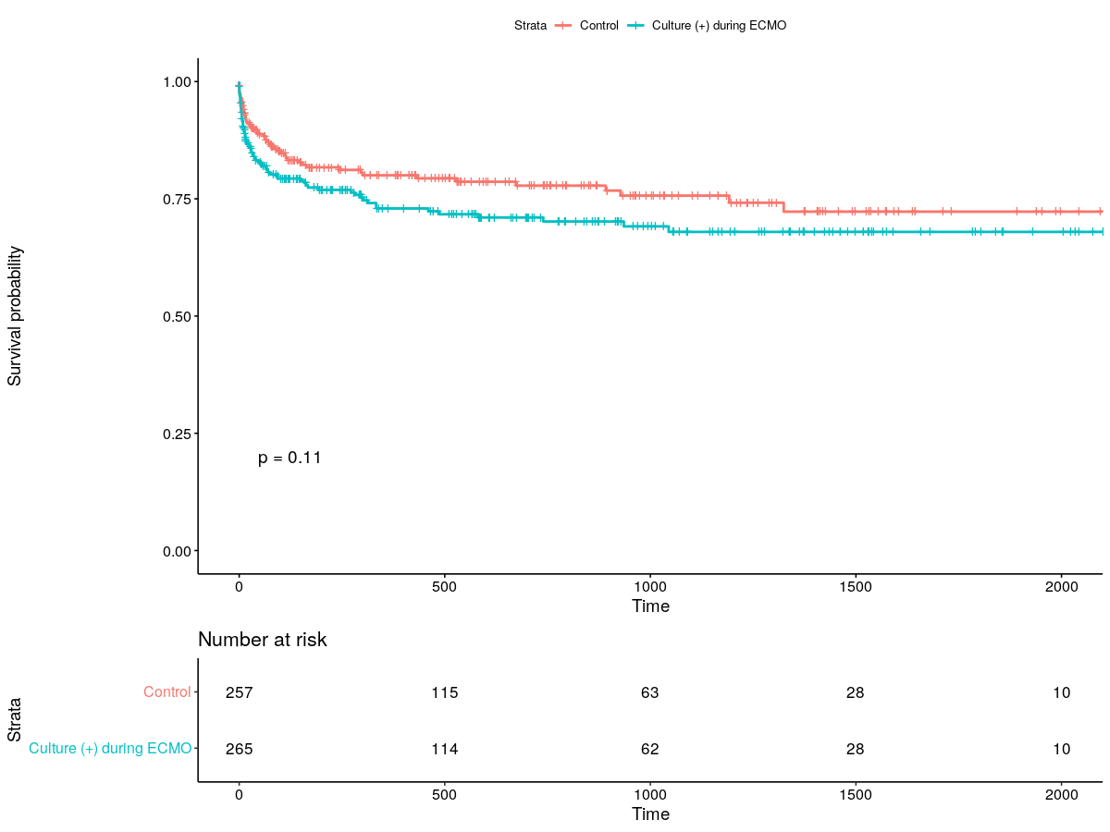
Survivors after ECMO
Successful weaning 환자 대상으로
ECMO 삽입 기간내 culture (+) vs. culture (-)

Slide 16
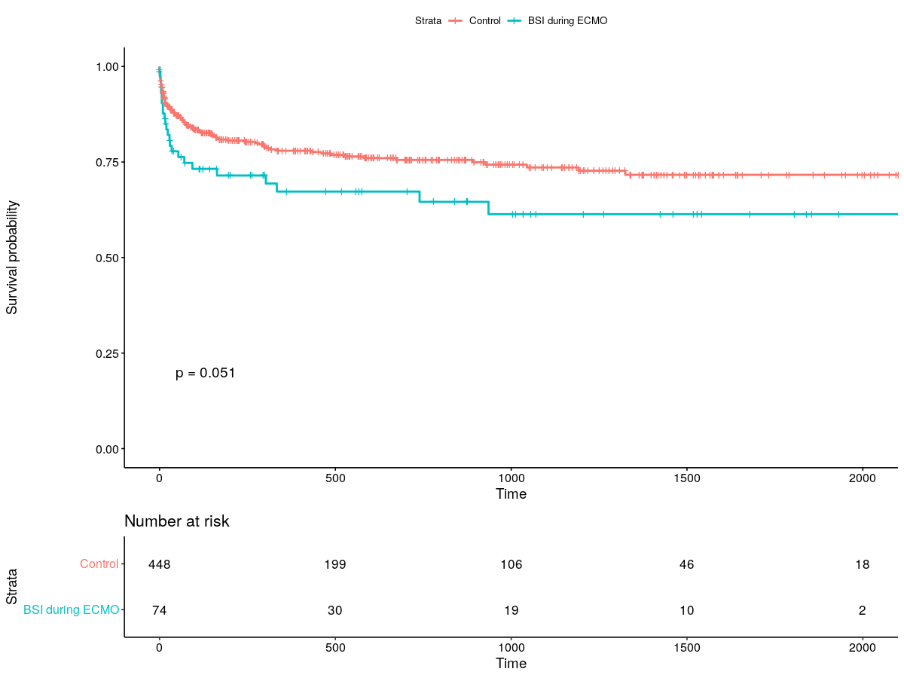
Survivors after ECMO – BSI during ECMO
Successful weaning 환자 대상으로
ECMO 삽입 기간내 Blood culture (+) vs. culture (-)

Slide 17
대략 결론을
ECMO 삽입 후 빠른 시일(7일) 내에 발생한 BSI가 환자 예후에 안 좋은 영향을 미친다.
반면 RTI/UTI 등은 큰 영향을 미치는 것 같지 않다.
ECMO 삽입 당시 aseptic technique이 중요하며, 또한 그외 infection도 적극적으로 Mx. 하여 BSI 발생을 억제해야할 것이다…
이런 식으로 방향을 잡아볼까 합니다.

Slide 18
추가
Multivariable Cox
Age
PMH - Malignancy, HTN, current smoker, CKD, PAOD
Lab- Hb, platelet, lactate, CRP(?)
ECPR, ECMO indication
Culture result

